Slide 1
Localization of Working Memory using tfMRI
By: Anthony Bet, Tan Gemicioglu and Yolanda Katsaiti
Pod name: Incompatible Butterflies
Group name: (M)A(S)TY
Project Mentor: Dr Takuya Ito Project TA: Dr Mo Shahdloo Pod TA: Abe Leite

Slide 2
Project Idea
Goals
What is working memory? Working memory enables short-term storage of relevant task information to guide future actions
Which brain regions are activated in each working memory task? (Answered)
Which functional brain networks are engaged in working memory? (Somewhat answered)
What is the flow of information in the brain during a working memory task? (Could not be answered using this dataset)

Slide 3
Project Methods
Dataset
Tasks
Analysis
HCP working memory task-based fMRI dataset
High-level parcellation of brain regions
Tasks done by a large number of users (N=100)
N-back task with 0 or 2 length sequences and body, face, place and tool stimuli
Contrast between 0-back vs 2-back tasks across 360 brain regions using t-test
Contrast between 0-back vs 2-back tasks across 360 brain region using GLM modeling

Slide 4
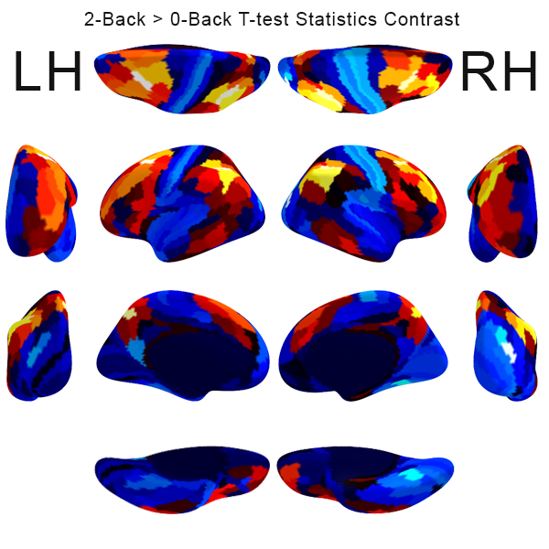
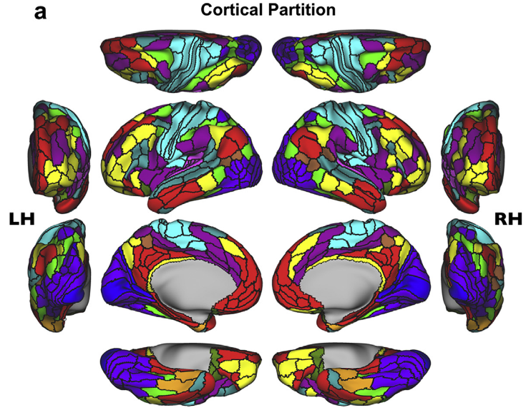
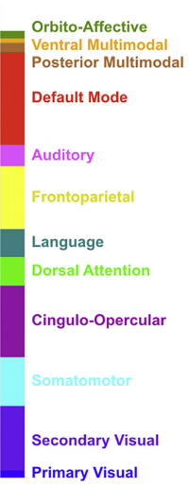
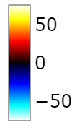
GLM results
False discovery rate correction with q < 0.05
Ji et al., (2019) Neuroimage

Slide 5
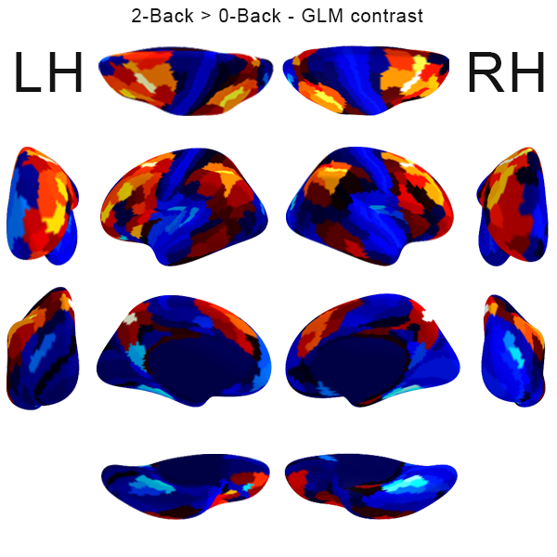
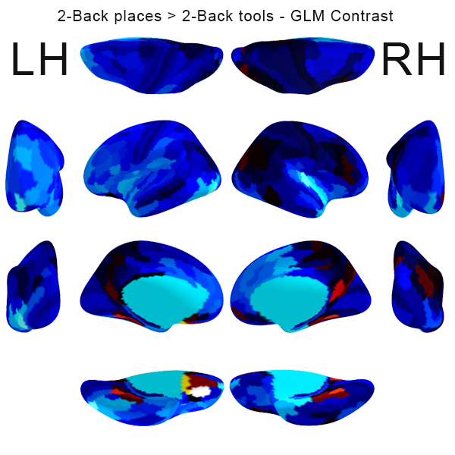
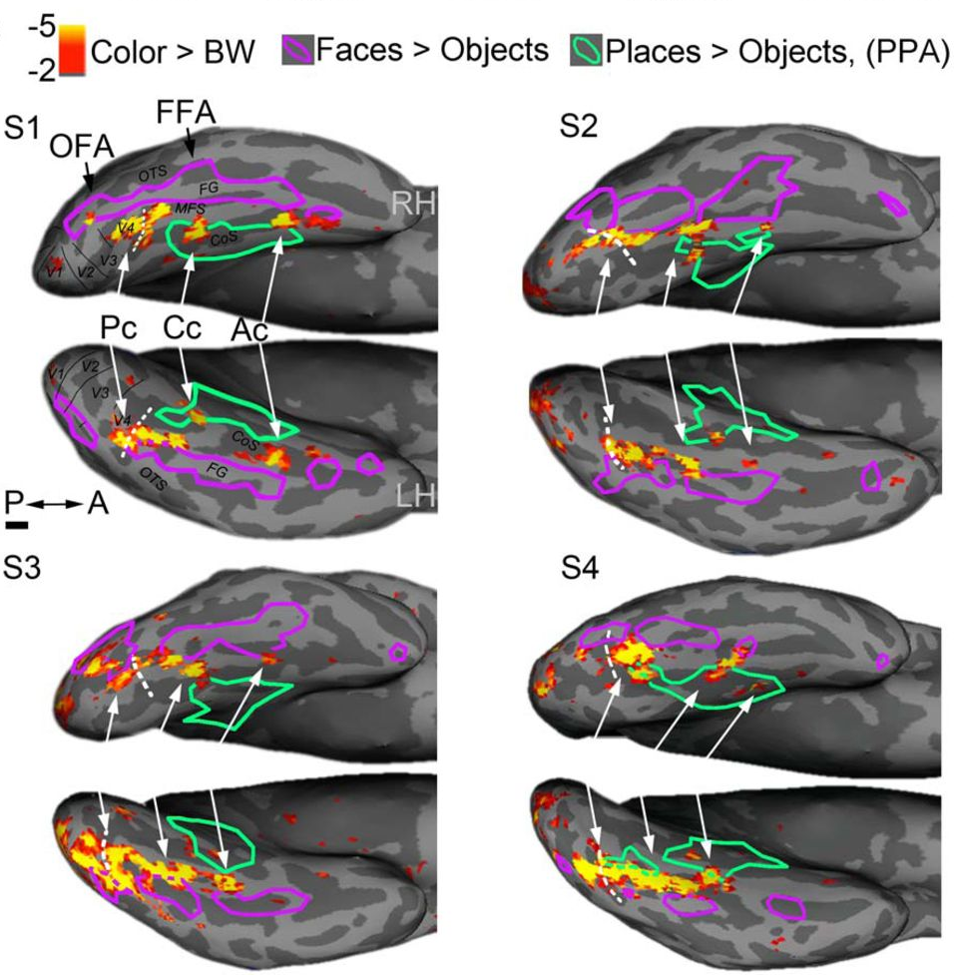
GLM results
Color-Biased Regions of the Ventral Visual Pathway Lie between Face- and Place-Selective Regions in Humans, as in Macaques, Lafer-Sousa et al. (2016) J Neurosci.

Slide 6
Conclusions & Future Directions
Working memory load isolates activations in the frontoparietal network, and de-activations in visual cortex
Comparing stimulus conditions during working memory can isolate activations relevant for specific stimuli in visual cortices
Suggests visual activations are responsive to information held in working memory in the absence of the actual visual stimulus
Future directions
Look at differences in activations and network involvement during the presentation of a stimulus versus the remembering of a stimulus

Slide 7
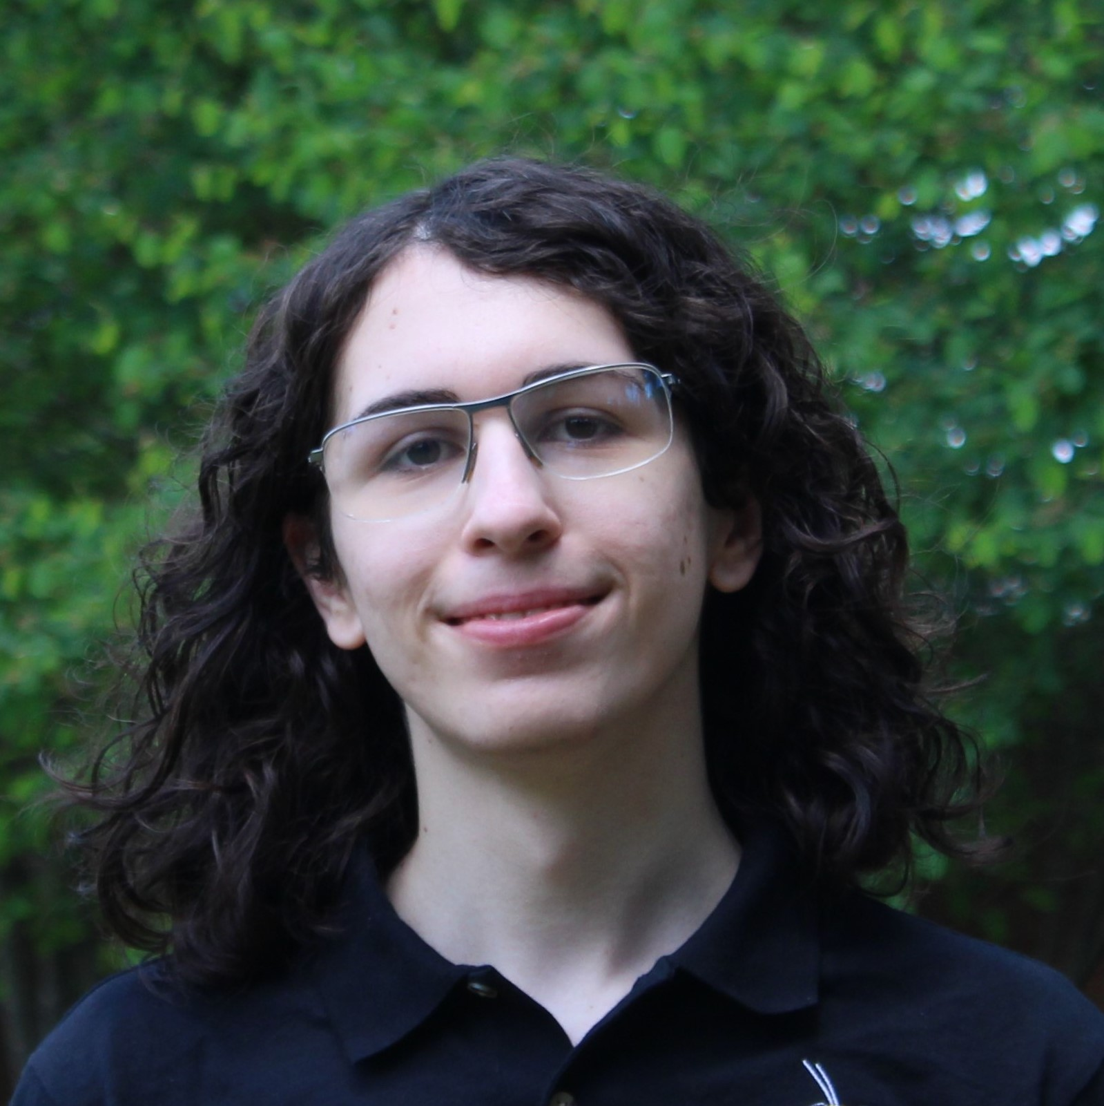

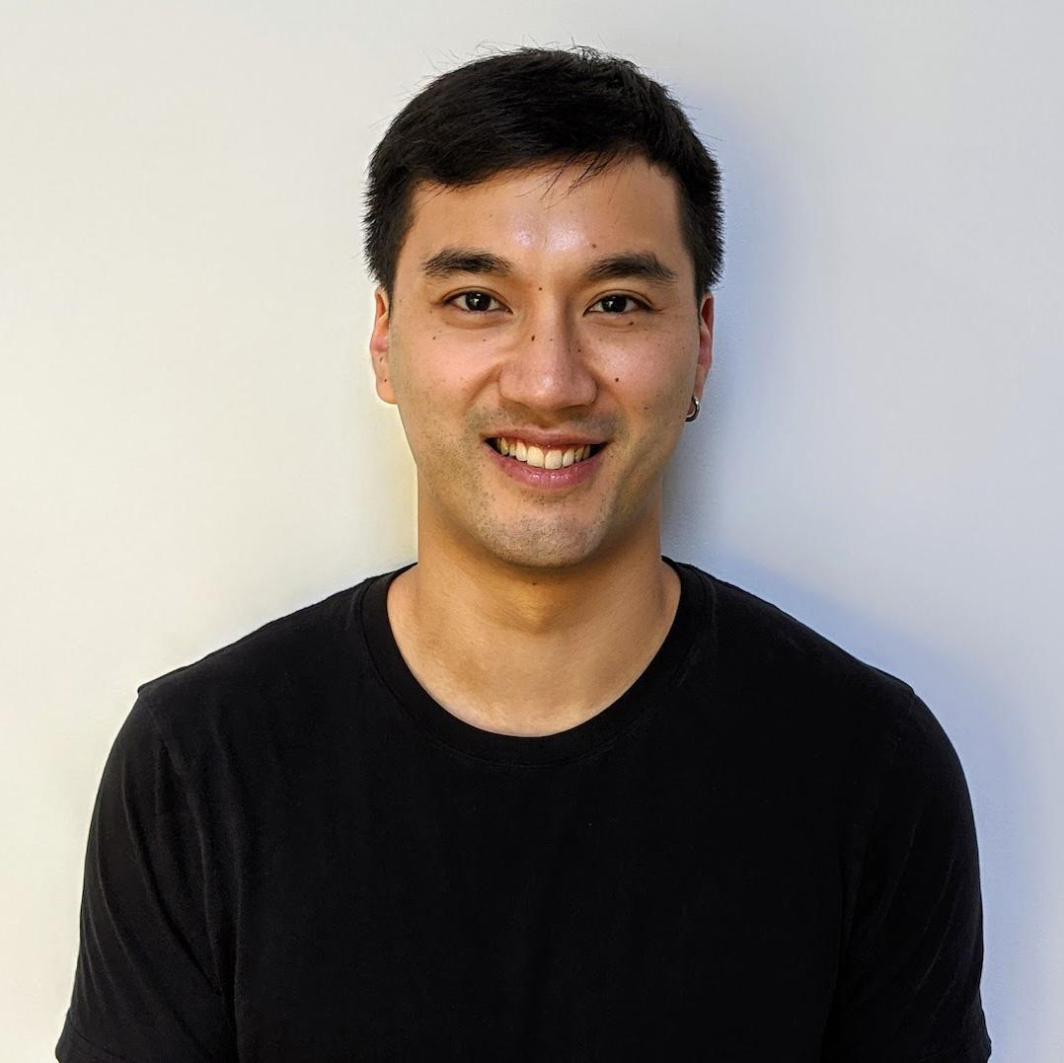


Who are we?
Anthony Bet B.S. in Physics at Universidade Federal de Santa Catarina
Tan Gemicioglu
B.S. in Computer Science
at Georgia Tech
Yolanda Katsaiti Msc in Neuroscience at National and Kapodistrian University of Athens
Takuya Ito
Postdoctoral Researcher in Theoretical Neuroscience
at Yale University School of Medicine
Mo Shahdloo Postdoctoral Researcher at Functional MR Imaging of the Brain at University of Oxford
Abe Leite PhD student in Computer Science and Cognitive Science at Stony Brook University

Slide 8
References
Baddeley A. (1992). Working memory. Science (New York, N.Y.), 255(5044), 556–559. https://doi.org/10.1126/science.1736359
Barch, D. M., Burgess, G. C., Harms, M. P., Petersen, S. E., Schlaggar, B. L., Corbetta, M., Glasser, M. F., Curtiss, S., Dixit, S., Feldt, C., Nolan, D., Bryant, E., Hartley, T., Footer, O., Bjork, J. M., Poldrack, R., Smith, S., Johansen-Berg, H., Snyder, A. Z., Van Essen, D. C., … WU-Minn HCP Consortium (2013). Function in the human connectome: task-fMRI and individual differences in behavior. NeuroImage, 80, 169–189. https://doi.org/10.1016/j.neuroimage.2013.05.033
Cohen, J. D., Perlstein, W. M., Braver, T. S., Nystrom, L. E., Noll, D. C., Jonides, J., & Smith, E. E. (1997). Temporal dynamics of brain activation during a working memory task. Nature, 386(6625), 604-608.
Ji, J. L., Spronk, M., Kulkarni, K., Repovš, G., Anticevic, A., & Cole, M. W. (2019). Mapping the human brain's cortical-subcortical functional network organization. NeuroImage, 185, 35–57. https://doi.org/10.1016/j.neuroimage.2018.10.006
Kandel, E. R., Schwartz, J. H., & Jessell, T. M. (2000). Principles of neural science. New York: McGraw-Hill, Health Professions Division.
Mackey, W.E., Curtis, C.E. Distinct contributions by frontal and parietal cortices support working memory. Sci Rep 7, 6188 (2017). https://doi.org/10.1038/s41598-017-06293-x
Rosa Lafer-Sousa, Bevil R. Conway and Nancy G. Kanwisher. Journal of Neuroscience 3 February 2016, 36 (5) 1682-1697; DOI: https://doi.org/10.1523/JNEUROSCI.3164-15.2016

Slide 9
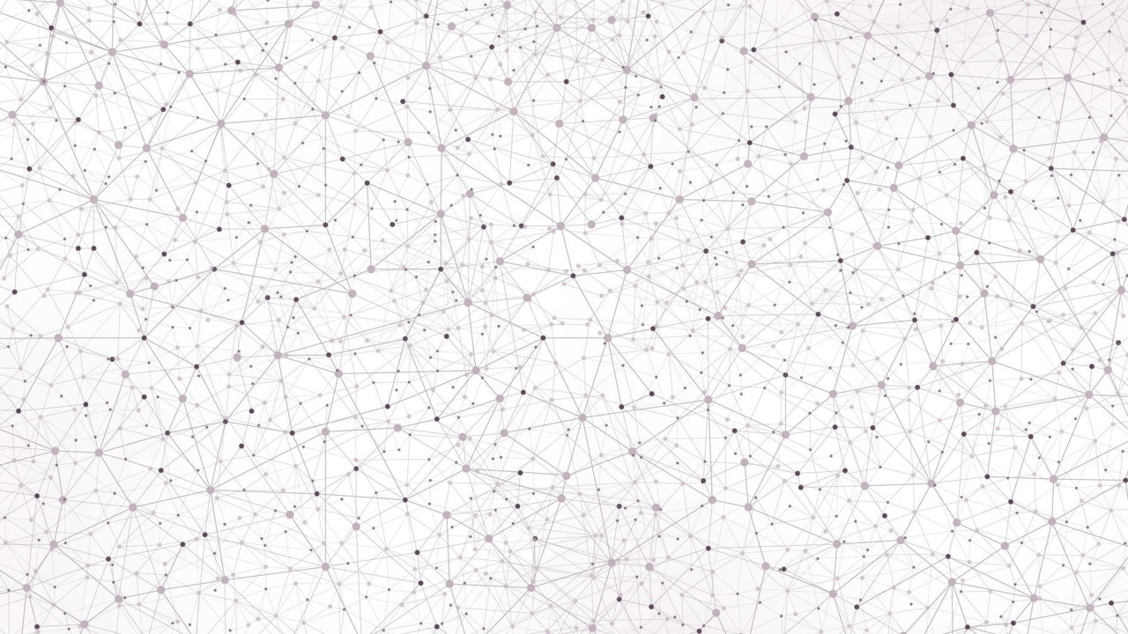
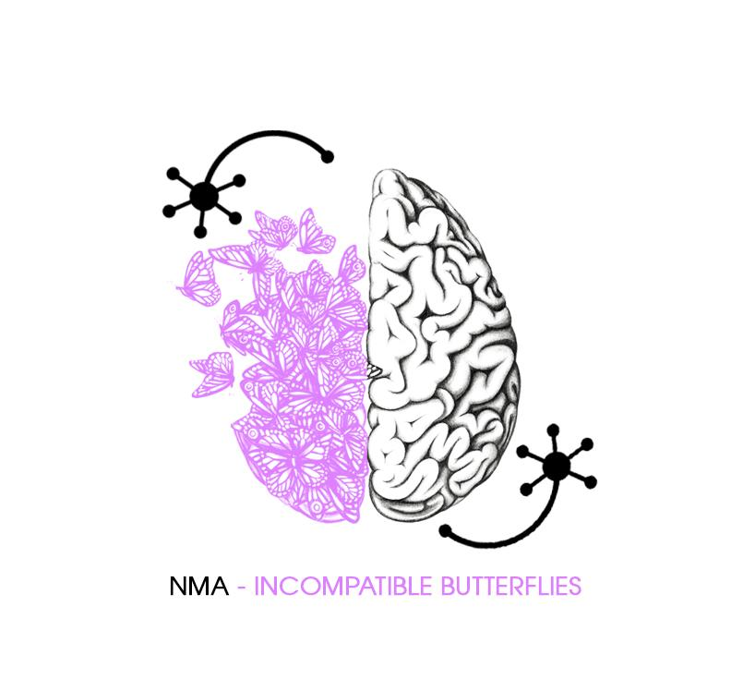
print ("Thank you")

